Slide 1
Customer Churn Analysis
FITLY ANALYTICS
📈
Executive Summary
Churn is highest among Free-tier users (41%).
Low engagement and slower support resolution drive churn.
Early engagement, re-engagement, and faster support can improve retention.
Presented by: Tarek Dib 02/5/2026 For Senior Leadership
Notes:
To start, here’s the executive summary of our churn analysis. We found that churn is heavily concentrated among Free-tier users, with 41% leaving within the first month. The main drivers are low engagement and longer support resolution times. By focusing on early engagement, re-engagement strategies, and improving support efficiency, we have a clear path to improving retention across our customer base.

Slide 2
Project Overview & Business Goals
📈
FITLY ANALYTICS
◎ Primary Purpose
Identify factors associated with customer churn to inform data-driven strategies for improving retention and service quality.
🎯 Business Goals
> Reduce monthly churn, with a focus on high-risk Free-tier users. > Improve early user engagement to support long-term retention. > Identify leading indicators for ongoing churn monitoring.
❓Key Questions
> Which customer segments and subscription tiers have the highest churn rates?
> Which user behaviors are associated with higher churn risk?
> How is support resolution time related to customer churn?
Notes:
The primary purpose of this project is to identify the key factors driving customer churn, so we can design data-driven strategies to retain customers and improve service quality. Specifically, we examine which subscription tiers experience the highest churn, how user engagement behaviors relate to churn risk, and whether slower support resolution times are associated with higher customer attrition. These questions guide both our analysis and our recommendations

Slide 3
🎯Key Metrics to Monitor
📈
FITLY ANALYTICS
◎ Current Outcome Metrics
Churn Rate (%) – % of users leaving per plan or segment.
Support Efficiency – average resolution time; delays can drive churn.
◎ Current Leading Indicators (Calculated from User Activity Data)
Total Events – total number of actions performed by a user; low activity may indicate risk of churn.
Active Days – number of distinct days a user was active; captures consistent engagement.
Days Since Last Activity (DSLA) – calculated as the difference between a user’s last activity and the latest event in the dataset; identifies inactive users who may be at risk of churn.
◎ Potential Future Metrics (Post-Intervention)
Re-engagement Rate – % of previously inactive users returning after interventions.
Engagement Level Over Time – tracking trends in active days and events after campaigns.
Notes:
Currently, we track churn rate and support efficiency as outcome metrics. From our event data, we’ve derived key leading indicators: total events, active days, and Days Since Last Activity (DSLA). Total events measures engagement intensity, active days tracks consistency over time, and DSLA identifies users who have been inactive and could be at risk of churn. In the future, once re-engagement campaigns are implemented, we can track re-engagement rate and ongoing engagement trends to measure the effectiveness of these interventions.

Slide 4
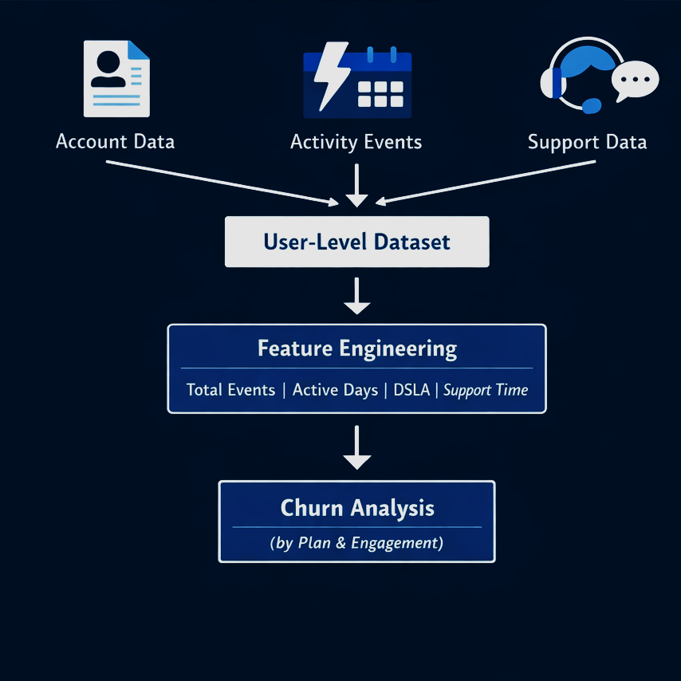
Data & Methodology
📈
FITLY ANALYTICS
Notes:
This analysis is based on three primary data sources: account data, user activity event logs, and customer support data. We first cleaned and validated the data, combining all sources into a single user-level dataset and ensuring consistency across user IDs. From the activity data, we engineered key engagement metrics such as total events, active days, and Days Since Last Activity, alongside support efficiency metrics. Finally, we analyzed churn rates by plan and examined how engagement and support factors are associated with churn.

Slide 5
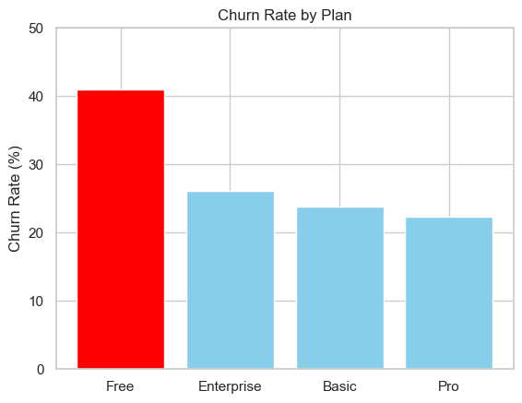
Key Finding #1: High Churn is Concentrated among Free, Low-Engagement Users
📈
FITLY ANALYTICS
Free Tier: Highest churn, driven by low engagement.
Users with 1 recorded event → ~46% churn rate
Paid Subscriptions (Pro, Basic, Enterprise):
Average churn = ~24%
Suggests higher perceived value and/or better support experience
Early engagement and onboarding represent the largest opportunity for churn reduction.
Notes:
Churn is heavily concentrated in the Free tier. Users who only engage once have an extremely high churn rate of around 46%, suggesting that many users fail to reach an initial value moment. In contrast, paid users churn at roughly half that rate, which points to stronger perceived value, higher engagement, or a better overall support experience

Slide 6
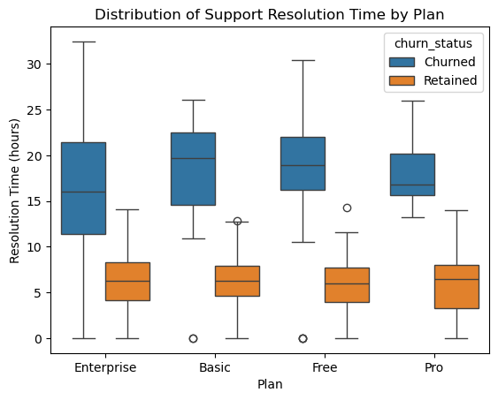
Key Finding #2: Churn is driven by Free Plan Usage and Support Experience
📈
FITLY ANALYTICS
Number of support tickets does not strongly correlate with churn.
Churned users consistently experience longer resolution times than retained users, even within the same subscription plan.
Free-tier users face the longest average resolution time (~10.8 hours).
Inactive users average ~17 hours, roughly 3× higher than users who remained active.
Users on the Free subscription plan, particularly those with low engagement and slower support responsiveness, exhibit a significantly higher risk of churn compared to paid subscribers.
Notes:
Interestingly, churn is not driven by how often users contact support, but by how long it takes to resolve their issues. Across all subscription tiers, churned users experience longer resolution times than retained users. This is especially pronounced among Free-tier and inactive users, who face the longest delays. These findings suggest that support speed, not volume, is a key driver of churn

Slide 7
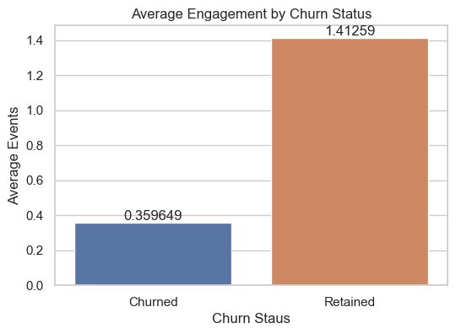
Key Finding #3: Higher Engagement Strongly Improves Retention
📈
FITLY ANALYTICS
Retained users exhibit significantly higher activity than churned users.
On average, retained users have ~4x more recorded events than churned users.
Churn rates decrease sharply as engagement increases
Even modest increases in user engagement are associated with substantial improvements in retention
Notes:
Engagement is one of the strongest predictors of retention. Retained users are significantly more active, generating roughly four times as many events as churned users. As engagement increases, churn drops sharply, suggesting that early and sustained interaction with the product is critical to keeping users retained

Slide 8
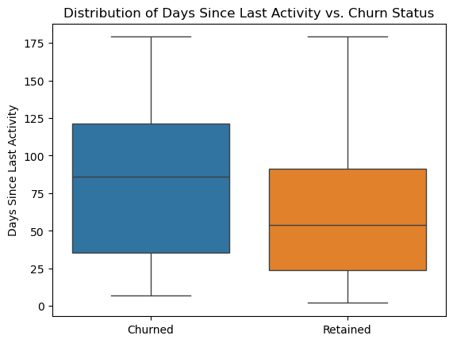
Key Finding #4: User Inactivity is a Strong Predictor of Churn
📈
FITLY ANALYTICS
Churned users experience much longer periods of inactivity prior to leaving.
Mean days since last activity:
Inactive / churned users: ~86 days
Retained users: ~54 days
Prolonged inactivity is a strong early warning signal for churn.
Churn is rarely sudden; it is typically preceded by disengagement.
Notes:
When we look at inactivity, the pattern is very clear. Churned users stop engaging much earlier than retained users. On average, churned users are inactive for around 86 days compared to 54 days for retained users. This gap shows that prolonged inactivity is not just correlated with churn—it is an early warning signal that allows for proactive intervention.

Slide 9
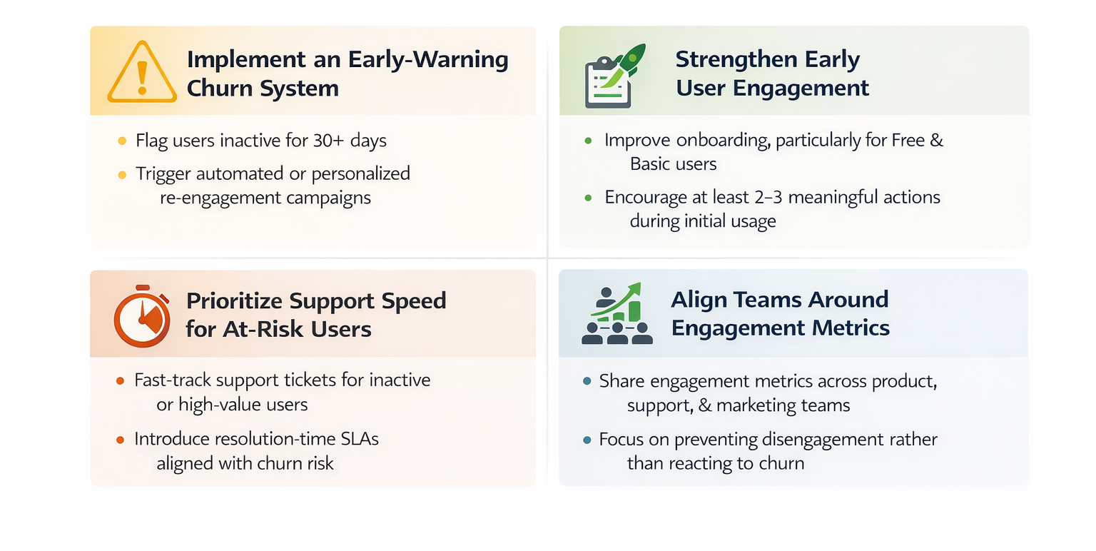
Recommendations & Next Steps
FITLY ANALYTICS
📈
Notes:
These four recommendations directly address the key drivers we identified. We suggest implementing an early-warning system for inactivity, strengthening early engagement, prioritizing support for at-risk users, and aligning teams around shared engagement metrics.

Slide 10
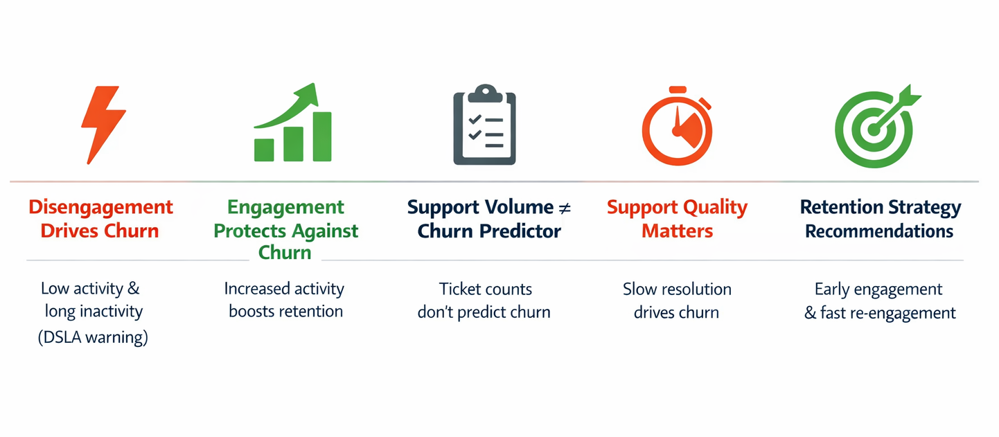
Conclusion: Key Drivers & Retention Insights ☑
FITLY ANALYTICS
📈
Notes:
Our analysis reveals five key takeaways. First, disengagement drives churn, with Days Since Last Activity serving as a strong early warning. Second, engagement—even modest—is protective. Third, support ticket volume does not predict churn, but fourth, support quality clearly matters, as longer resolution times are associated with churn. Finally, to reduce churn, our recommendations focus on early engagement, proactive re-engagement, and fast, high-quality support

